Slide 1
CAPSTONE PROJECT
Presented By: Rohit Gupta
Email ID: rohit.sparklebox@gmail.com

Slide 2
BUSINESS OBJECTIVE
Hired as a Data engineer project where we have work on employee data from the year 1980s to 1995s.
Database of employees are provided in six csv file.
Perform different type of analysis and create data model and data pipeline to under stand the cause of exit of employee from the different department.

Slide 3
Data Used and Description
We have six tables.
1. Department (depart.csv):
2. Department Employee(dept_emp.csv):
Column Name | Details | Data Type
dept_no | Unique id for each department | Character
dept_name | Department Name | Character
Column Name | Details | Data Type
Emp_no | Employee ID | Integer
Dept_no | Unique Id for each department | Character

Slide 4
3. Department Manager(dept_manager.csv)
4. Employees(employees.csv)
Column Name | Details | Data Type
Dept_no | Unique id for each department | Character
Emp_no | Employee Number | Integer
Column Name | Details | Data Type
Emp_no | Employee Id | Integer
Emp_titles_id | Designation Id | Character
Birth_date | Date of Birth | Character
First_name | First Name | Character
Last_name | Last Name | Character
sex | Gender | Character
Hire_date | Emp Hire Date | Character
No_of_projects | No. of projects worked | Integer
Last_performance_rating | Last year performance rating | Character
left | Employee left the organization | Character
Last_date | Last date of employment | Character

Slide 5
5. Salaries (salaries.csv)
6. Titles(titles.csv)
Column Name | Details | Data Type
Emp_no | Employee id | Integer
Salary | Employee’s Salary | Integer
Column Name | Details | Data Type
Title_id | Unique id type of employee | Character
title | Designation | Character

Slide 6
Technology stack used
MySQL (to create database)
Linux Commands
Scoop (To transfer data from MySQL to HDFS/Hive)
HDFS (to store the data)
Hive to create database and perform EDA)
SparkSQL ( to perform EDA)
SparkML (to perform model building)

Slide 7
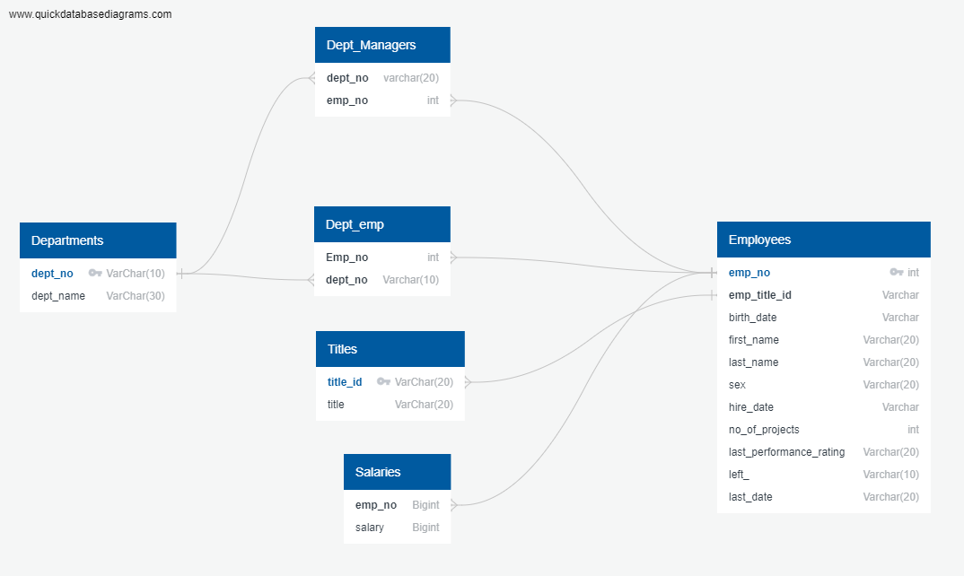
ER DIAGRAM (Data model)

Slide 8
Architecture of pipeline
Perform EDA analysis using Spark SQL, Hive
CSV Files
MySQL Server
HDFS/Hive
Sqoop
Avro
File
Build ML Model

Slide 9
challenges
Loading the data from My SQL server to HDFS in the form of AVRO format using Scoop command
Loading the AVRO file from HDFS to Hive.
Read the AVRO file from HIVE to Spark SQL for performing EDA
Building the ML Data Model.

Slide 10
Next Steps
Able to load the MySQL table into HDFS with the help of compressed file format using sqoop command by creating a directory after then providing proper path.
Move the avsc file from local path to HDFS while creating Hive table.
For reading the data from hive table uses certain library.

